Slide 1
KDD Project Presentation
Team members:
Sampath Kumar Gunasekaran
Nitish Rangarajan
Yuvaraj Sundarrajan
Ajay Kumar Prathap
Shrutha Kashyap

Slide 2
PROBLEM STATEMENT
A managed healthcare organization believes they suffer from over $30 million in preventable losses annually due to the readmission of patients who are discharged from the hospital too soon.
AIM: To develop a model of readmission risk that doctors can consider when determining when to discharge a patient.

Slide 3
Data Cleaning
The dataset originally had over 10000 records.
The encounters that resulted in death of the patient or discharge to a hospice were removed to avoid biasing on the dataset.
The following R commands were used to achieve this: patients <- subset(patients, discharge_disposition_id != "Expired")
patients <- subset(patients, discharge_disposition_id != "Hospice / home")
Now the dataset was reduced to 9772 records.

Slide 4
Data Inconsistencies: Rules
A1Cresult %in% c('Norm','None','>7','>8')
readmitted %in% c('FALSE','TRUE')
gender %in% c('Male','Female')
insulin %in% c('Down','No','Up','Steady')
time_in_hospital>0
weight %in% c('[0-25)','[25-50)','[50-75)','[75-100)','[100-125)','[125-150)','[150-175)')
race %in% c('Caucasian','AfricanAmerican','Asian','Hispanic','Other')
change %in% c('No','Ch')
diabetesMed %in% c('Yes','No')
insulin %in% c('Up','Down','No','Steady')

Slide 5
Data Inconsistencies
Rules were run to determine violations on the dataset
library(editrules)
(E<-editfile("rules.txt"))
ve <- violatedEdits(E, patients)
summary(ve)
plot(ve)

Slide 6
Data model:
dat1 : A1Cresult %in% c('>7', '>8', 'None', 'Norm')
dat2 : change %in% c('Ch', 'No')
dat3 : diabetesMed %in% c('No', 'Yes')
dat4 : gender %in% c('Female', 'Male')
dat5 : insulin %in% c('Down', 'No', 'Steady', 'Up')
dat6 : race %in% c('AfricanAmerican', 'Asian', 'Caucasian', 'Hispanic', 'Other')
dat7 : readmitted %in% c(FALSE, TRUE)
dat8 : weight %in% c('[0-25)', '[100-125)', '[125-150)', '[150-175)', '[25-50)', '[50-75)', '[75-100)')

Slide 7
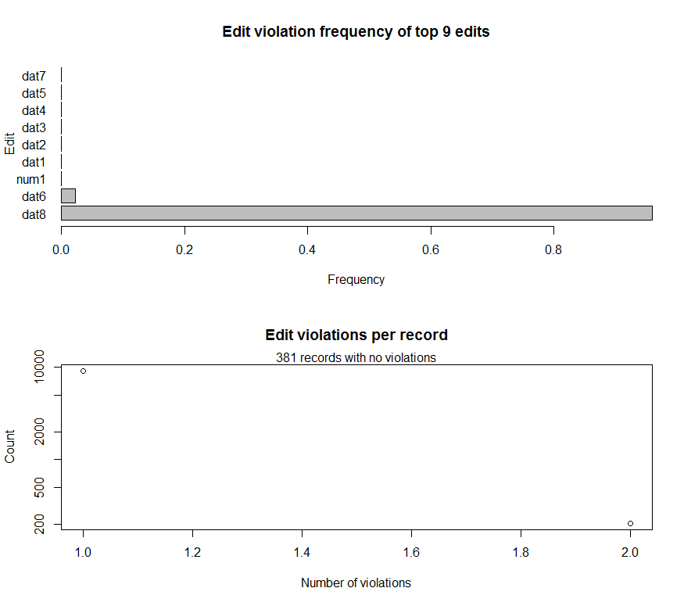

Slide 8
Correlation Analysis: Feature selection
The following attributes are used in relation to readmission attribute:
Race
Age
A1Cresult
Change in Medication

Slide 9
Correlation Analysis: Race
The first criterion considered was Race. The following R commands were run to obtain the correlation with readmission attribute:
>tab <- xtabs(~race + readmitted, data = patients) >barplot(tab, main="Data Distribution by Readmitted patients vs Race results",xlab="Race Results",col=c("darkgreen","blue","red","orange") legend = rownames(tab), beside=TRUE) >summary(assocstats(tab))

Slide 10
Results:
Call: xtabs(formula = ~race + readmitted, data = patients)
Number of cases in table: 9772
Number of factors: 2
Test for independence of all factors:
Chisq = 58.37, df = 5, p-value = 2.644e-11
X^2 df P(> X^2)
Likelihood Ratio 60.077 5 1.1719e-11
Pearson 58.366 5 2.6439e-11
Phi-Coefficient : NA
Contingency Coeff.: 0.077
Cramer's V : 0.077

Slide 11
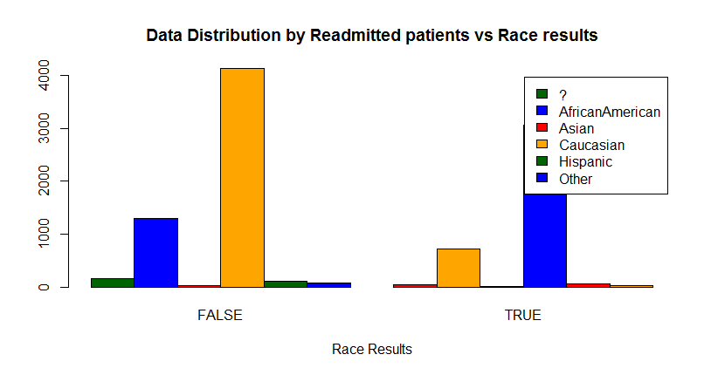
Bar-Plot for Race and Readmitted

Slide 12
Correlation analysis: Age
>tab <- xtabs(~age + readmitted, data = patients) >barplot(tab, main="Data Distribution by Readmitted patients vs Age results",xlab="Age Results",col=c("darkgreen","blue","red","orange","yellow","maroon","pink","violet","cyan","magenta"),legend = rownames(tab), beside=TRUE)
>summary(assocstats(tab))

Slide 13
Results:
Call: xtabs(formula = ~age + readmitted, data = patients)
Number of cases in table: 9772
Number of factors: 2
Test for independence of all factors:
Chisq = 100.81, df = 9, p-value = 1.078e-17
X^2 df P(> X^2)
Likelihood Ratio 104.77 9 0
Pearson 100.81 9 0
Phi-Coefficient : NA
Contingency Coeff.: 0.101
Cramer's V : 0.102

Slide 14
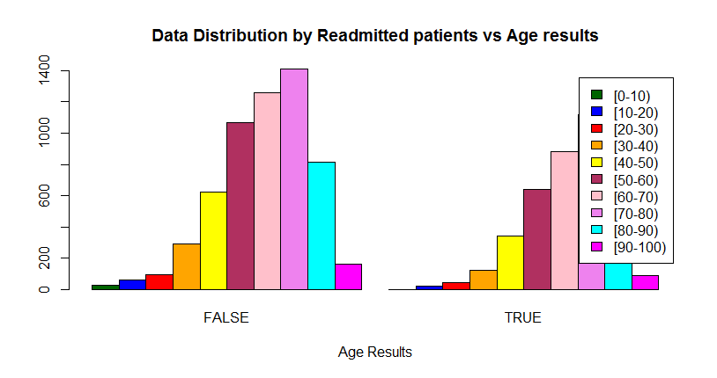

Slide 15
Correlation Analysis: HbA1C
>tab <- xtabs(~A1Cresult + readmitted, data = patients)
>barplot(tab, main="Data Distribution by Readmitted patients vs HBA1C results",xlab="HBA1C Results", col=c("darkgreen","blue","red","orange"),legend = rownames(tab), beside=TRUE)
>summary(assocstats(tab))

Slide 16
Results:
Call: xtabs(formula = ~A1Cresult + readmitted, data = patients)
Number of cases in table: 9772
Number of factors: 2
Test for independence of all factors:
Chisq = 8.836, df = 3, p-value = 0.03156
X^2 df P(> X^2)
Likelihood Ratio 8.9155 3 0.030436
Pearson 8.8358 3 0.031556
Phi-Coefficient : NA
Contingency Coeff.: 0.03
Cramer's V : 0.03

Slide 17
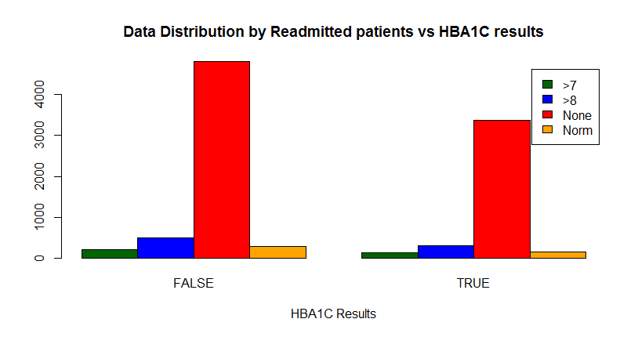

Slide 18
Correlation analysis: Change in Medication
>tab <- xtabs(~change + readmitted , data = patients)
>barplot(tab, main="Data Distribution by Readmitted patients vs Change in Medication results", xlab="Change in Medication Results", col=c("darkgreen","red"), legend = rownames(tab), beside=TRUE)
>summary(assocstats(tab))

Slide 19
Results:
Call: xtabs(formula = ~change + readmitted, data = patients)
Number of cases in table: 9772
Number of factors: 2
Test for independence of all factors:
Chisq = 22.304, df = 1, p-value = 2.327e-06
X^2 df P(> X^2)
Likelihood Ratio 22.276 1 2.3612e-06
Pearson 22.304 1 2.3268e-06
Phi-Coefficient : 0.048
Contingency Coeff.: 0.048
Cramer's V : 0.048

Slide 20
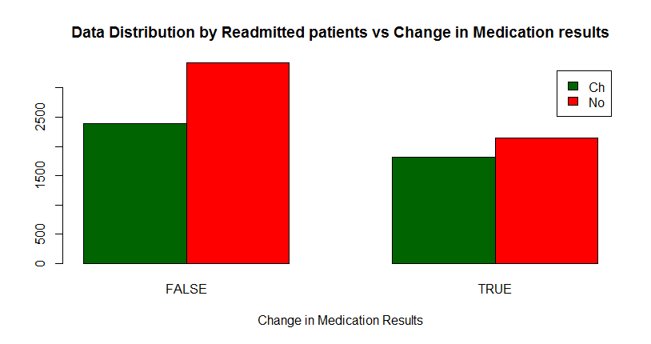

Slide 21
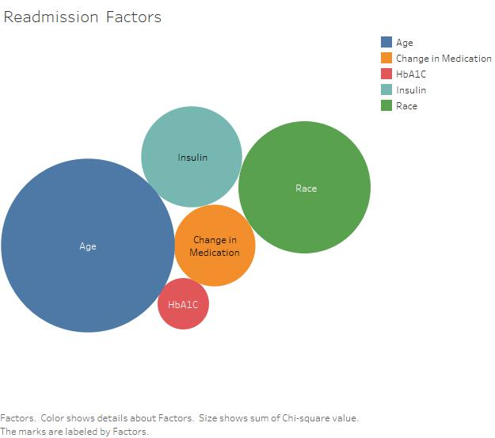
Summary of analysis

Slide 22
Additional Tasks:
How the discharge disposition affects change in medication and other factors. WHY? This task helps predict the patterns in insulin level, HbA1c test results and change of medication based on discharge disposition. TECHNIQUES: linear regression

Slide 23
Additional Tasks
Predicting the likelihood of a non-diabetic patient (say Circulatory disorder) going for a secondary/diabetes diagnosis. WHY? The likelihood of a patient being readmitted is high when a patient has both circulatory disorder as well as diabetes. So this helps us indirectly in predicting readmission rate. TECHNIQUES: correlation test, multivariate multiple regression.

Slide 24
Additional Tasks:
How insulin and change in medication affects HbA1C result. WHY? This task helps prevent early readmission indirectly by monitoring the administration of medication and insulin levels that affect the HbA1C result. Some patients may choose not to take the HbA1C tests. Hence we could use insulin and change in medication to predict readmission. TECHNIQUES: Correlation test, Multivariate multiple regression.

Slide 25
CHALLENGES
Multiple Collinearity
Removing duplicate observations
Getting familiar with R

Slide 26
THANK YOU!

